Slide 1
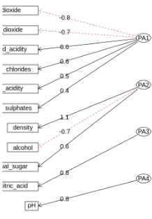
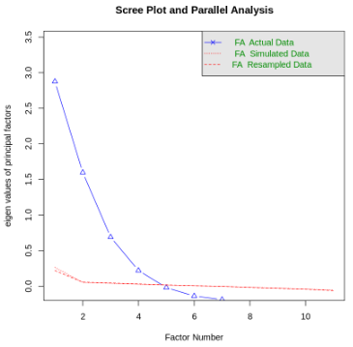
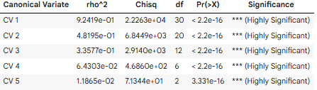
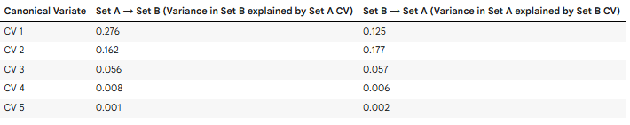
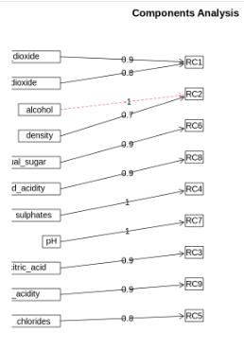

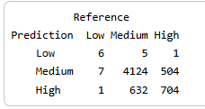

Wine Quality
Features & Factors
CANONICAL CORROLATION ANALYSIS
A Multivariate Data Analysis
CV 1
FACTOR ANALYSIS
0.9613
CV 2: 0.6942
CV 3: 0.5795
CV 4: 0.2536
CV 5: 0.1089
4
Identified Factors
Chi Square
39010.89
QLD Confusion Matrix
PRINCIPAL COMPONENT ANALYSIS
CLUSTERING

